Slide 1

“A true visionary is that which grants us sight, for it is sight that guides us to our destination.”

Slide 2

Home 360: NYC
AR Powered Visualization platform for NYC’s leading Builders and Luxury property buyers.
POINT . SCAN. EXPERIENCE
By:
Team 360
(Sumit, Swara, Parth, Soumya, Aarth)

Slide 3

The Elephant in the Room 🏡
Are they selling what you want
to buy?
Do you see what you want to buy?
Are you able to plot your choices,
before and after you buy?

Slide 4




The Game Changer💡
“Home 360: NYC” isn’t just a listing service
it’s a dynamic, predictive property platform powered by Augmented Reality.
Immersive 3D Tours
Through AR Visualizations
Sales and Experience
Platform by Builders
Interaction enriched
Customer Portal
Interior Decor Filters
and Visualization

Slide 5
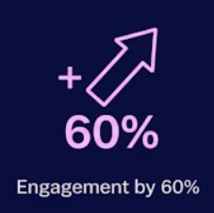
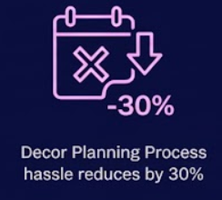


Recognition & Success:
Proof in the Property 🏆🚀
We're not just selling houses; we're generating serious traction and credibility.
Featured Spotlight
"This platform is single-handedly making open houses obsolete. A game changer for Gen Z buyers."
— Tech Digest Magazine

Slide 6


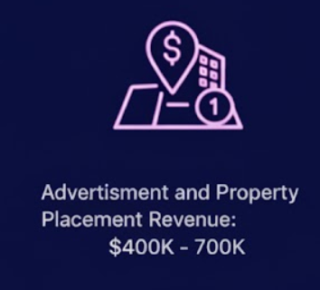

Investment Insights: Show Me the Money 💰📊

Slide 7
Let’s Make a Deal! 🤝
The real estate market is ripe for disruption. We have
the technology, the traction, and the team.
Invest Now.
$400K
Marketing
Improving Technical Enrichment
User Experience
Home 360: NYC – Turning bricks into dreams!

Slide 8
Let’s Make a Deal! 🤝
In-Return for
$1.25 Per Subscription for initial 6 months
+
5% Revenue Shares
Don't just watch from the sidelines as we turn the archaic property search into a seamless, modern experience.
Home 360: NYC – Turning bricks into dreams!

